Slide 1
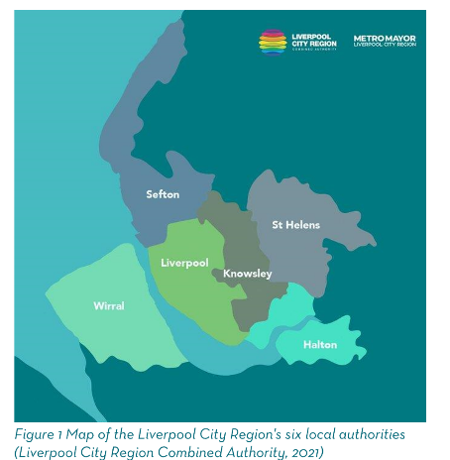
Liverpool City Region Careers Hub
To help every young person find their best next step
Andrew Rannard, Headteacher of De La Salle School
30 June 2021

Slide 2
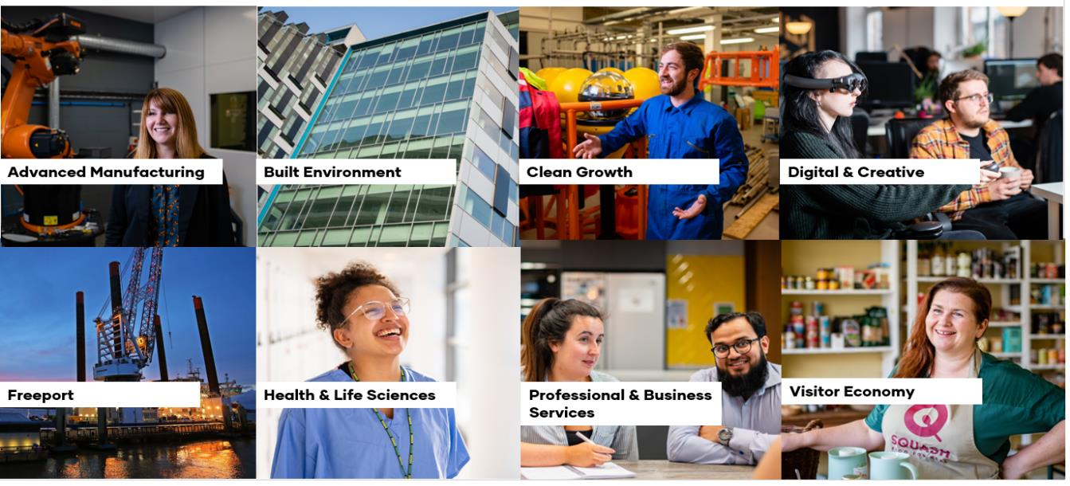
LCR is a Growing Economy
Liverpool City Region is a £32.3bn economy
The impact of the global recession affected the Liverpool City Region economy for longer than nationally, with sustained growth only returning in 2013
In the last five years (2013-18) nearly £2.8bn has been added to the economy, following the impacts of the Global Financial Crisis
In four of the last five year growth in the City Region has been higher than the national average
However, like nationally, growth rates have struggled to reach pre-recession levels

Slide 3
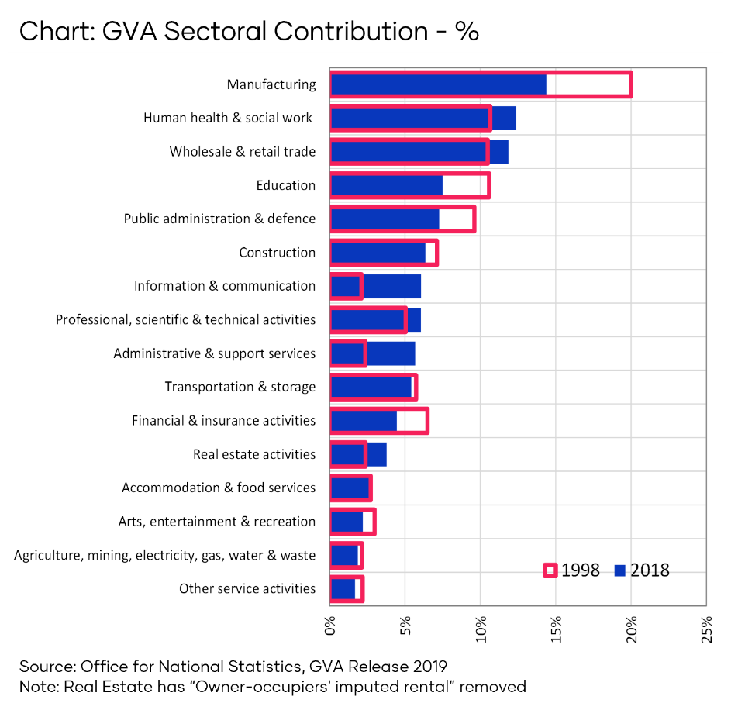
With Key Sectors
In Liverpool City Region almost 40% of gross value added (GVA) is generated by:
Manufacturing,
Human health & social work
Wholesale & retail
Over the past 20 years the contribution to GVA from Manufacturing has declined, along with Education, Public Admin and Finance & Insurance.
Sectors that have grown in significance include:
Human health & social work,
Wholesale & retail
Information & communication
Administrative & support services
The largest 5 sectors account for approximately 43% of all employment jobs in Liverpool City Region, compared to 35% nationally.
In GVA terms the largest 5 sectors account for 36% of all output in the City Region, compared to 27% nationally.
The public sector continues to contribute a larger share of GVA and employment jobs in the City Region than nationally.

Slide 4
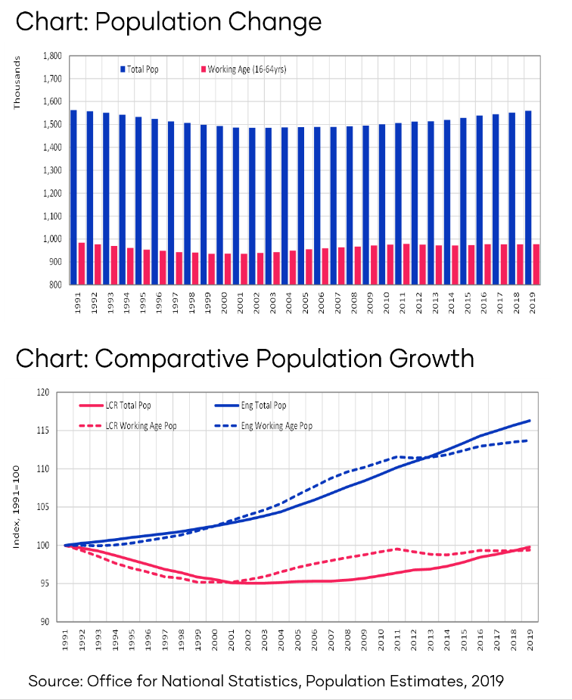
Population growth, but slower than average
Liverpool City Region has a population of 1.56 million, which has grown year on year since 2003.
There are 978,000 working are people in the City Region, with number having grown by 4.4% since 2000.
However both the total population and working age population have grown significantly slower than the national average.

Slide 5
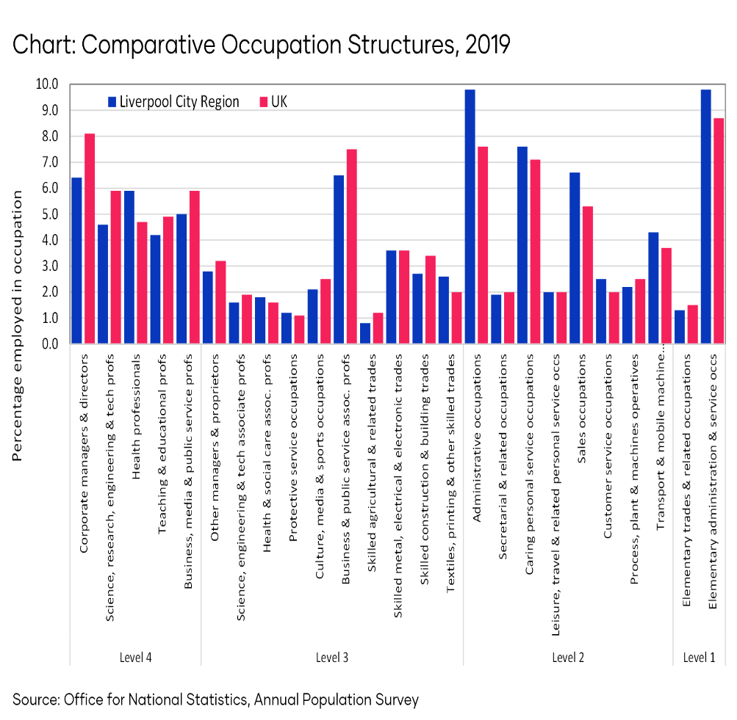
Similar occupational structure to UK
Overall Liverpool City Region has a similar breakdown to the UK in terms of occupational levels.
However the City Region has a higher proportion of people employed in Health related occupations.
In contrast there are fewer people employed in Corporate and Business related occupations.
Overall Liverpool City Regions has a smaller proportion of people employed in higher level occupations.

Slide 6
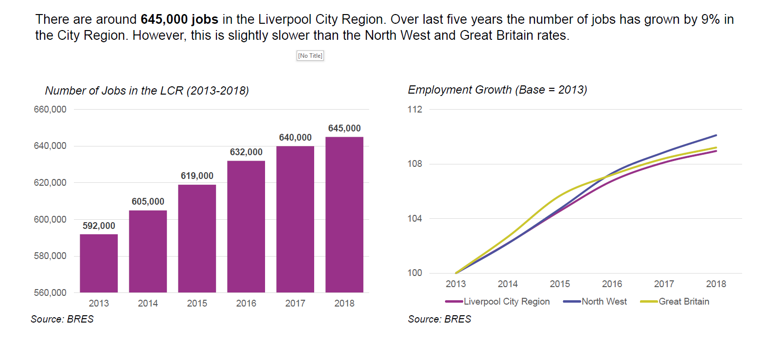
The number of jobs in the City Region is growing

Slide 7
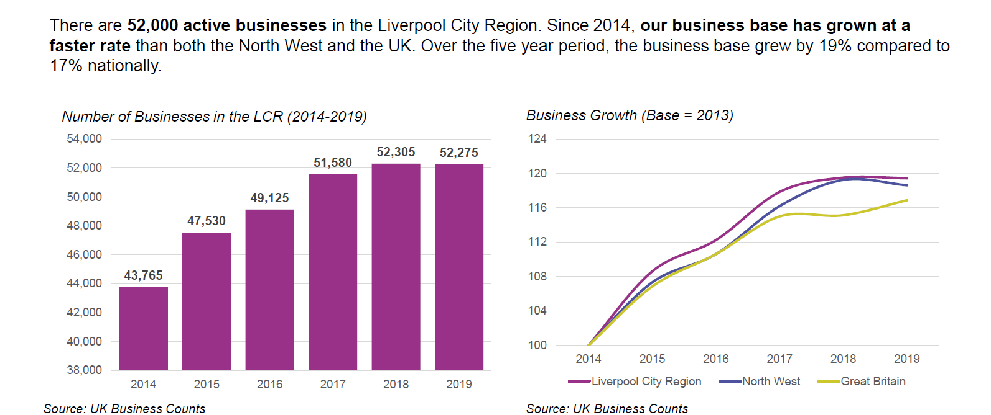
Our Business Base is growing at a pace …
www.growthplatform.org

Slide 8
Hannah Randles
Health & Life Sciences Champion
Growth Platform & Innovation Agency
www.growthplatform.org

