Slide 1
Creating Careers: Ask Us Anything
Season Two
Careers in Nursing
Thursday 21st October 2021
4.30 pm – 5.30 pm
Student Pre-work

Slide 2
Pre-work
Watch from 8 minutes to 23 minutes of our Creating Careers Season 2 launch session, focusing on mental health and psychological careers.
In your own words, explain what the benefits of mentoring are.
Hint: Consider personally, professionally and the types of people who can benefit.
2. One a scale of 1 to 10, how interested are you in being mentored?
1 = not interested, 10 = very interested. Explain your score!
Contact Creating Careers to discuss our 12-month mentorship offer to support you with health and social care career options.
One Million Mentors offer mentoring for young people aged 18-25. You can find out more about them here.
Find your local Mind services here to help support you with your mental health.
Alternatively, contact careershub@growthplatform.org and we can direct you to other mentorship services in your region.
Our next session will look at different types of nursing within the NHS.
3. Research the roles of an adult nurse and a mental health nurse.
In what ways are the roles similar and different? Explain your answer.
4. Are you interested in a career in mental health services, such as mental health nursing? Explain your answer.
Questions to ask
Using what you have learned from your pre-work, think of three questions that you would like to ask at our event.
Is there anything you don’t understand or would like more information on? You may even come up with more questions as you watch the webinar.
1.
2.
3.
Useful careers tips
Whilst listening, note down any inspirational or interesting advice that you hear which could help you on your careers journey
Now head over to your Creating Careers Roadmap to evaluate today’s event…

Slide 3
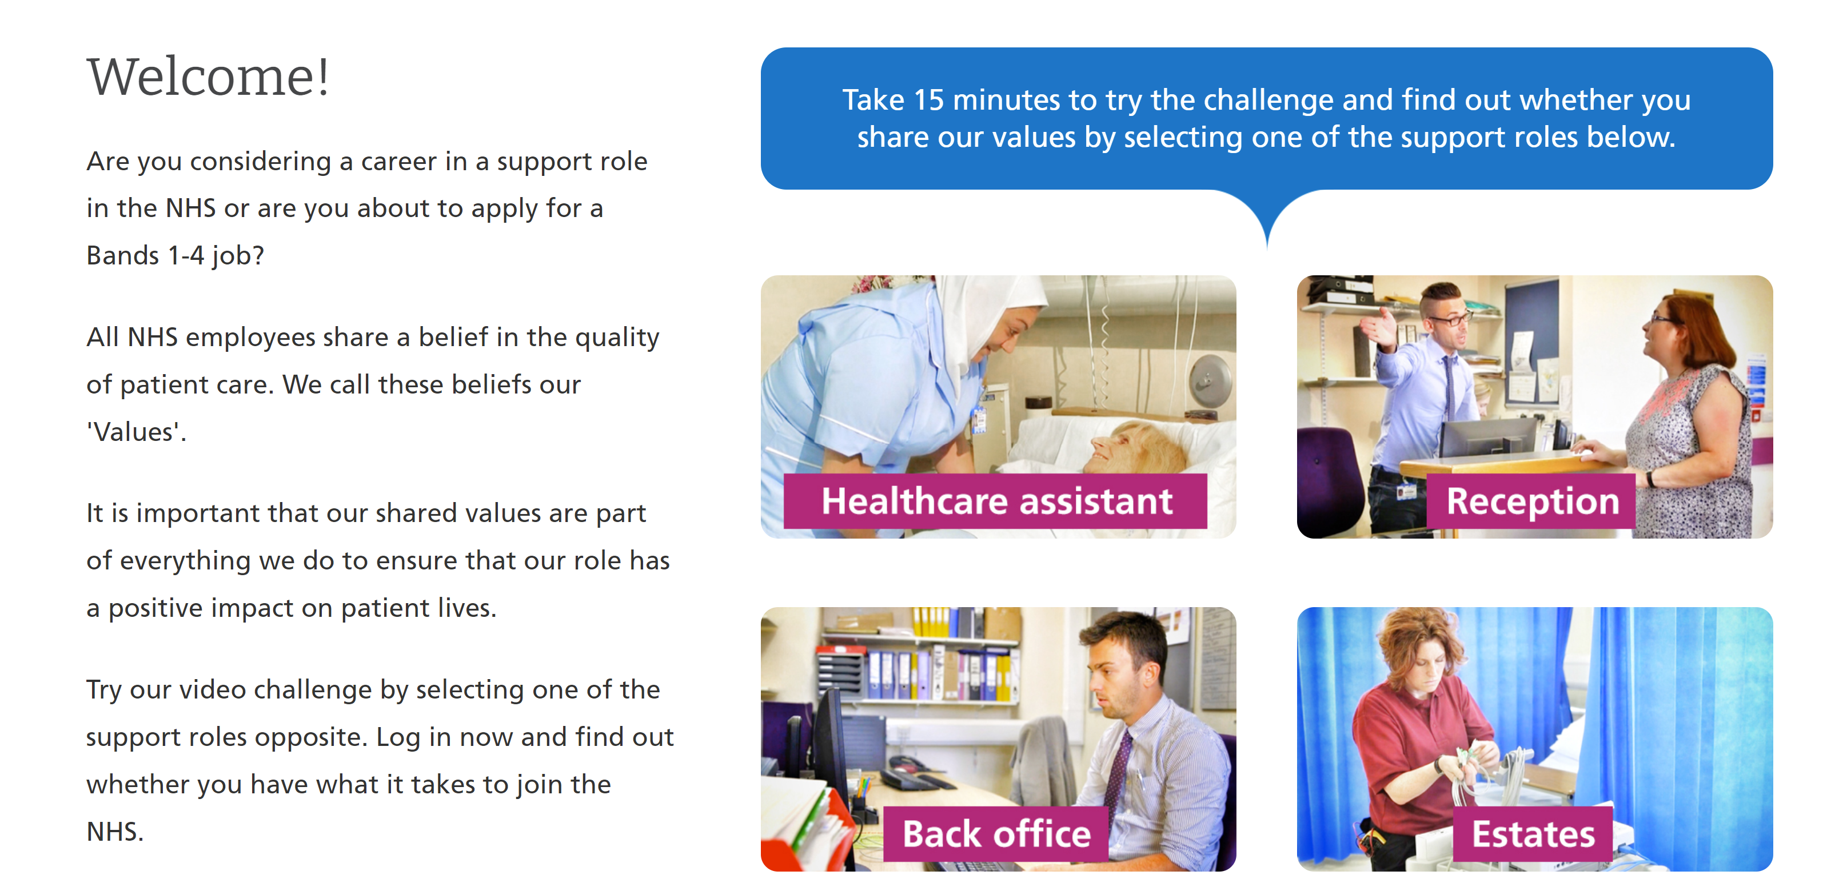
Values Challenge - click here to begin!
Values of the NHS Constitution
If you're applying for a job either directly in the NHS or in an organisation that provides NHS services, you'll be asked to demonstrate the values of the NHS Constitution and how they would apply in your everyday work.
You can find out more about NHS values here.
Complete the values challenge to see if you share the NHS’ values!

Slide 4
This programme is more than one day…
By joining this webinar, you are now a part of the Creating Careers family.
This includes The Liverpool City Region Careers Hub, Health Education England, GM Higher, Shaping Futures, NHS Careers NW, Lancashire Future U, Cumbria Hello Future and Cheshire and Warrington’s commitment to sharing opportunities that enable you to train towards a career in health and social care.
You can also independently sign up to Cheshire and Warrington Higher Horizons, Youth Hub by Be More and Cheshire and Warrington Opportunities who can help you to access these webinars and support you going forward.
Do you have any questions?
You can ask us about GCSE options, Sixth-Form or College choices and everything university related. Talk to the Shaping Futures team via live chat here or click on any of the above links for your area.
Creating Careers: Ask Us Anything - Health and Social Care Webinars
Build your health and social care knowledge! Even if you have an interest in one career role, these webinars are an opportunity to see how the 350+ NHS roles interlink to create a world-class health and social care system.
For more information, please see the next slide.

Slide 5
Creating Careers: Ask Us Anything
Health and Social Care Webinars
Season Two
Sign up here
Thursday 21st October:
Nursing
Thursday 11th November:
Midwifery & Neonatal
Nursing
Thursday 25th November:
Social Care
Thursday 9th December:
Occupational Therapy and
Physiotherapy
Develop your health and social care knowledge and receive free individual careers support across North West England.
Each session is live from 4.30 pm - 5.30 pm
Year 9-13 students, North West England
Parents, carers and guardians are welcome too!
Find out more about the 350+ exciting careers in the NHS here.
Additionally, watch our Creating Careers video series to learn about the interesting health and social care career pathways that Liverpool City Region has to offer.
Don’t forget to check out the pre-work and Creating Careers Roadmap that accompany each episode!
For the latest careers updates & events, follow our Twitter page @LCRCareersEnt

Slide 6
Coming Soon On
Creating Careers: Ask Us Anything
2022
Dietitians
Speech and Language Therapists
Orthoptists
Osteopaths and Prosthetics
Diagnostic & Therapeutic Radiotherapists
Art & Music Therapists
Podiatrists
Operating Department Practitioners
AHP Support Workforce
Ambulance Services
Dentistry
Pharmaceutical
Estates & Facilities
Healthcare Science
Sign up details to be released December 2021
Find out more about each of these careers here.
Got a question?
Get in touch:
careershub@
growthplatform.org

