Slide 1
Development of LCR Be More
Skills & Apprenticeship Hub
Kamal Choudhary – Principal Officer
Jon Child – Digital Lead

Slide 2
Skills & Apprenticeship Hub

Slide 3
Skills & Apprenticeship Hub
Created in order to facilitate the closing of a historic Liverpool City Region skills gap with the rest of the country. Employers across the Liverpool City Region consistently reported in studies/questionnaires, that skills gaps prevented them from securing further growth.
Externally funded through the European Social Fund and the Strategic Investment Fund.
Notes:
The Skills and Apprenticeship Hub (SAH), together with its delivery partners, provides a one-stop shop for skills advice and support across the Liverpool City Region (LCR) in line with the Combined Authority’s (CA) One Front Door approach to business support.
The SAH offers an opportunity to simplify how employers and learners navigate the local skills system, providing much-needed strategic leadership and accelerating the delivery of local skills strategy.

Slide 4
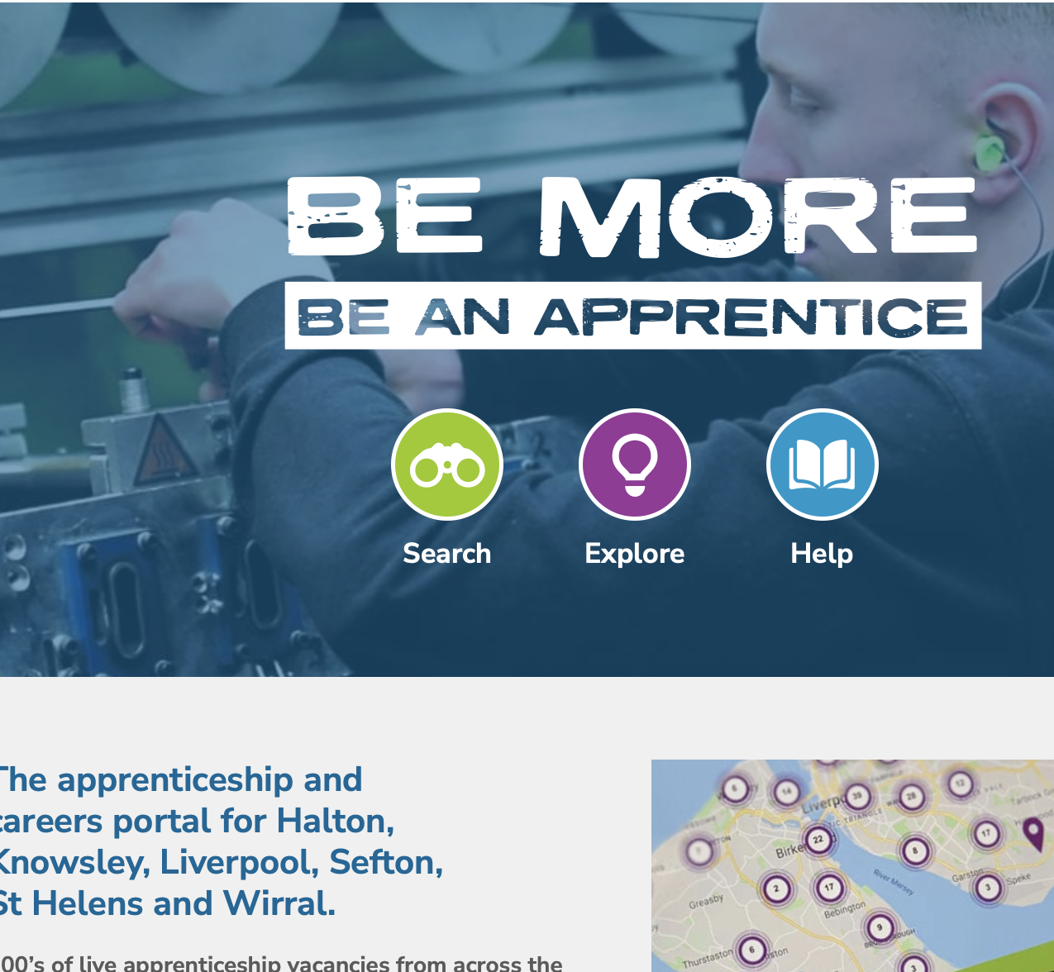
What is LCR Be More now?

Slide 5
What is LCR Be More now?
LCRCA have developed an apprenticeship careers portal, Be More, which promotes careers, posts vacancies, manages case studies and manages Ambassador activity and resources across all areas of LCR.
Notes:
LCRCA have developed an apprenticeship careers portal, Be More, which promotes careers, posts vacancies, manages case studies and manages Ambassador activity and resources across all areas of LCR.

Slide 6
What is LCR Be More now?
The content and layout of the existing Be More website was developed working with a number of stakeholder groups including a student review panel, training providers, local colleges and regional training officers.
Notes:
The content and layout of the existing Be More website was developed working with a number of stakeholder groups including a student review panel, training providers, and local colleges and regional training officers.

Slide 7
What is LCR Be More now?
LCRCA has secured further ESF funding to support the development and expansion of the Be More service. A key element of the funding request was for the further development of Be More to create an all age, all sector, CEIAG portal covering all areas of LCR.
Notes:
LCRCA has secured further ESF funding to support the development and expansion of the Be More service. A key element of the funding request was for the further development of Be More to create an all age, all sector, CEIAG portal covering all areas of LCR.

Slide 8
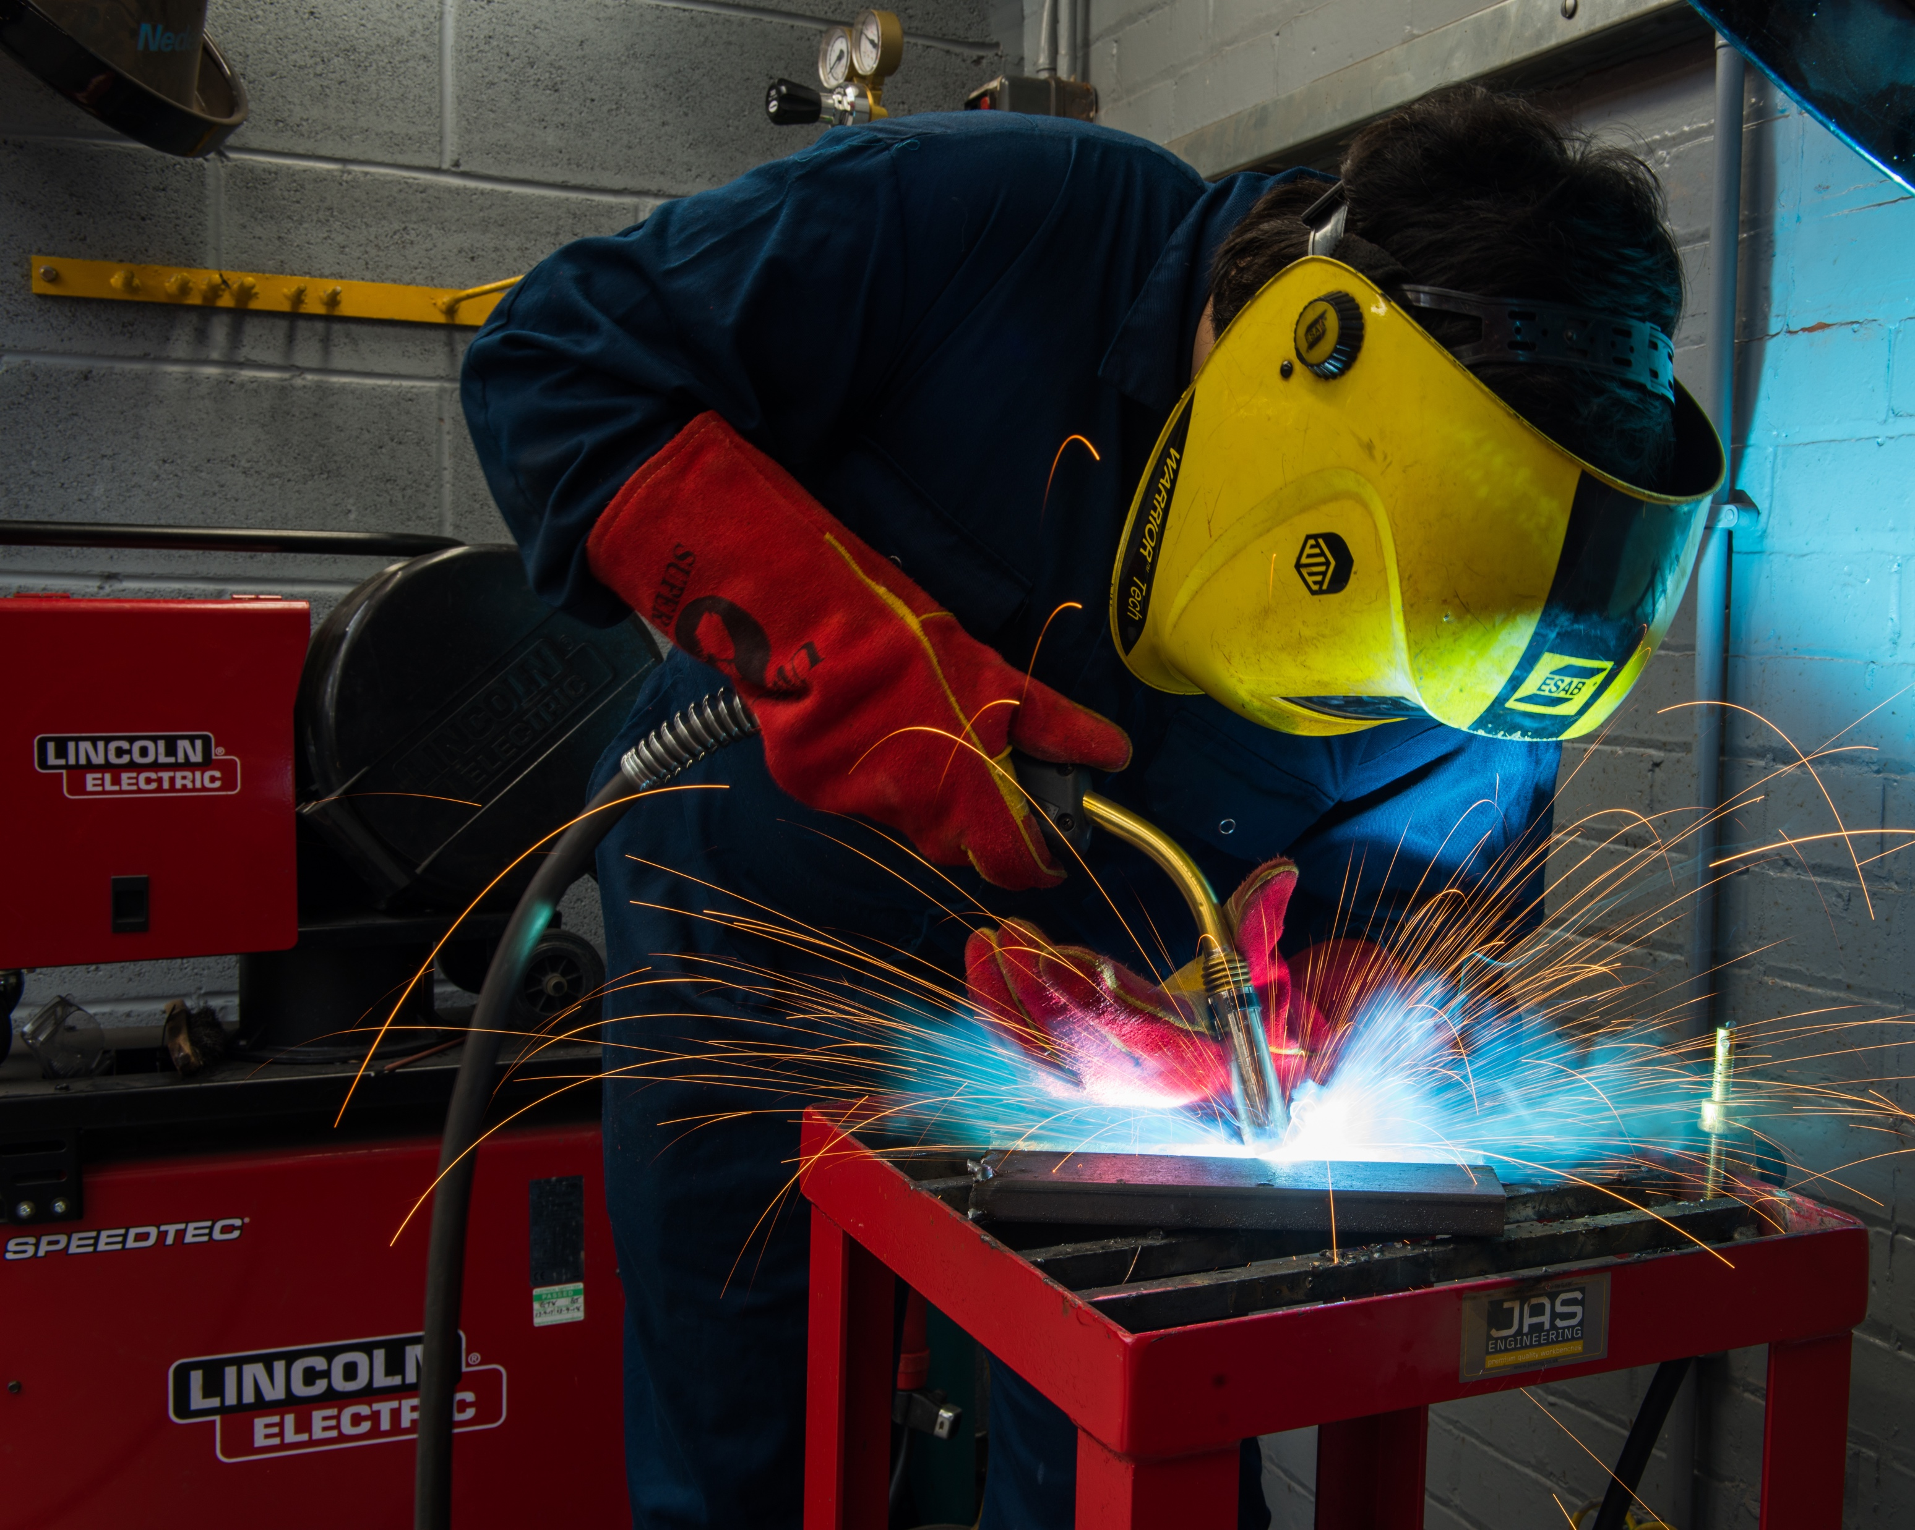
Redevelopment of LCR Be More

Slide 9
Redevelopment of LCR Be More
In it’s simplest form, the project will work towards ensuring that the Be More portal meets LCRCA’s aspiration of the website becoming the ‘go to’ resource for localise careers content and guidance.
Notes:
In it’s simplest form, the project will work towards ensuring that the Be More portal meets LCRCA’s aspiration of the website becoming the ‘go to’ resource for localise careers content and guidance.

Slide 10
How will this be realised?

Slide 11
How will this be realised?
Develop the Be More portal to simplify and enhance the support available to individuals and employers from across the LCR.
Notes:
Develop the Be More portal to simplify and enhance the support available to individuals and employers from across the LCR.
Develop content for the Be More Portal around three themes;
Attract
Recruit
Retain
Develop the Be More portal to provide a comprehensive careers IAG service to all LCR residents, employers, schools, and stakeholder groups and for each area within LCR.

Slide 12
How will this be realised?
Develop content for the Be More Portal around three themes;
Attract
Recruit
Retain
Notes:
Develop the Be More portal to simplify and enhance the support available to individuals and employers from across the LCR.
Develop content for the Be More Portal around three themes;
Attract
Recruit
Retain
Develop the Be More portal to provide a comprehensive careers IAG service to all LCR residents, employers, schools, and stakeholder groups and for each area within LCR.

Slide 13
How will this be realised?
Develop the Be More portal to provide a comprehensive careers IAG service to all LCR residents, employers, schools, and stakeholder groups and for each area within LCR.
Notes:
Develop the Be More portal to simplify and enhance the support available to individuals and employers from across the LCR.
Develop content for the Be More Portal around three themes;
Attract
Recruit
Retain
Develop the Be More portal to provide a comprehensive careers IAG service to all LCR residents, employers, schools, and stakeholder groups and for each area within LCR.

Slide 14
How will this be realised?
Produce detailed career information on the key sectors across LCR including;
details of the roles within sectors; and,
how individuals of all ages can access opportunities.
Notes:
Produce detailed career information on the key sectors across LCR including;
details of the roles within sectors; and,
how individuals of all ages can access opportunities.
Collate and aggregate skills LCR skills needs
Significant partnership engagement and contribution to the site with existing best practice content
Deliver against the underlying principle of avoiding duplication

Slide 15
How will this be realised?
Collate and aggregate skills LCR skills needs
Significant partnership engagement and contribution to the site with existing best practice content
Deliver against the underlying principle of avoiding duplication
Notes:
Produce detailed career information on the key sectors across LCR including;
details of the roles within sectors; and,
how individuals of all ages can access opportunities.
Collate and aggregate skills LCR skills needs
Significant partnership engagement and contribution to the site with existing best practice content
Deliver against the underlying principle of avoiding duplication

Slide 16
Why change?

Slide 17
Why change?
Pace of technology
Highlighting apprenticeships as attractive and viable career pathway
Changing the way in which we inform and share information

Slide 18
Digital Expectations

Slide 19
Digital expectations
Pandemic has accelerated digital transformation and the way in which people find and share information
User habits – higher reliance upon mobile technologies
Expectation of content to be more engaging
Content needs to reflect the local area

Slide 20
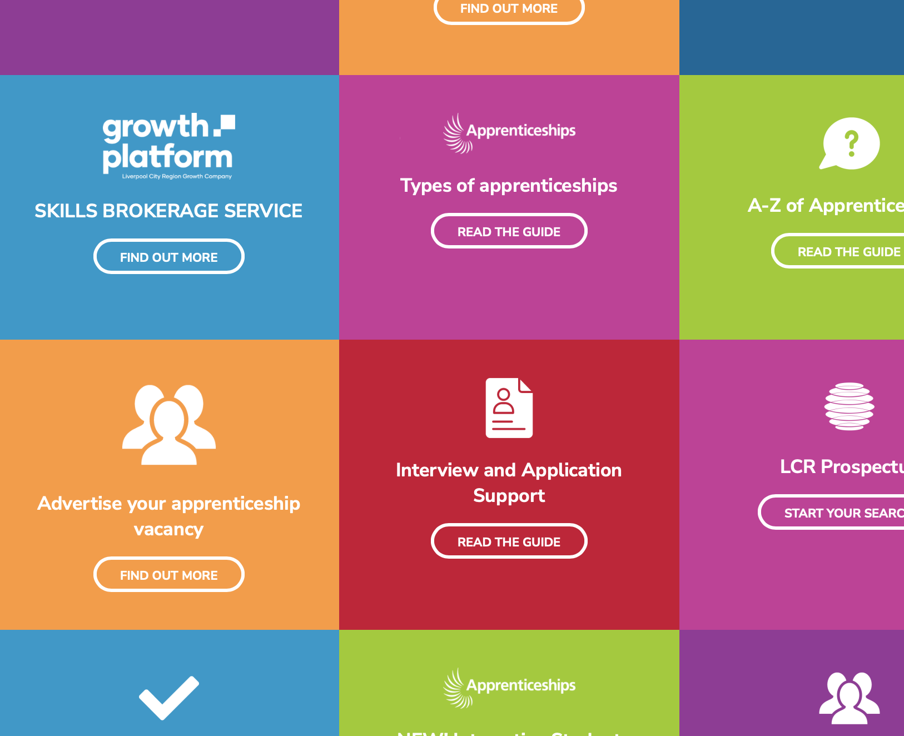
Content is key

Slide 21
Content is key
Engaging content from local apprentices and employers
Appetite/expectation of more video and audio content
Latest data such as LMI to help inform decisions
Users to be able to customise what they see and when
Information to be delivered rather than sought after

Slide 22
Something for everyone…

Slide 23
Something for everyone…
Content to be available and relevant to multiple audiences such as: Teachers, Careers Advisors, Parents, Students
Digital information packs/resources to be made available for download to reduce environmental impact such as printing

Slide 24
Innovation

Slide 25
Innovation
To build upon the leap start of the current platform
Push notifications to mobile devices such as new local apprenticeship vacancies
Website accompanied by mobile application for all current mobile devices (Apple, Android, Google)
Functionality to customise user experience

Slide 26
Collaboration

Slide 27
Collaboration
Project informed by focus groups held throughout LCR
Design and development work supported and informed by LCR students
IAG from local industry experts and thought leaders

Slide 28
Questions
Thank you

