Slide 1
Creating Careers: Ask Us Anything
Season Two
Ambulance Services
Thursday 28th April 2022
4.30 pm – 5.30 pm
Student Pre-work

Slide 2
If you think of the ambulance service, you’ll probably think of bright yellow vehicles and blue flashing lights, but there is a lot more to North West Ambulance Service than that.
1) Click here to watch the video introducing NWAS.
As you watch, write down the names of all the different jobs roles that are shown in the clip. Write down as many as you can.
2) Next to each job title that you wrote down, add one of the following symbols:
✓ if you think that you understand what this job involves
? if you have some idea about this role but are not completely sure
X if you don’t know anything about this job role.
3. Click to explore the different roles at NWAS or search for them using NHS Health Careers
Research one of the roles that you added a ✓ next to.
Make a note of any key facts that you didn’t know about the role.
What is the most important SKILL that you would need for this job? Explain your answer.
How interested are you in this role? Give this a score out of 10 and explain your answer.
0 = not at all interested, 10 = this is the job for me!
B) Select one of the roles that you added a ? next to.
Before you research the role, write an explanation of what you think this job is.
Now research the role, add in anything that you missed from your explanation and tick anything that you have already correctly included.
How interested are you in this role? Give this a score out of 10 and explain your answer.
0 = not at all interested, 10 = this is the job for me!
C) Research one of the roles that you added a X next to.
What do you think would be the biggest challenge AND the most rewarding part of this job? Explain your answer.
How interested are you in this role? Give this a score out of 10 and explain your answer.
0 = not at all interested, 10 = this is the job for me!
Questions to ask
Using what you have learned from your pre-work, think of three questions that you would like to ask at our event.
Is there anything you don’t understand or would like more information on? You may even come up with more questions as you watch the webinar.
1.
2.
3.
Useful careers tips
Whilst listening, note down any inspirational or interesting advice that you hear which could help you on your careers journey
Now head over to your Creating Careers Roadmap to evaluate today’s event…

Slide 3
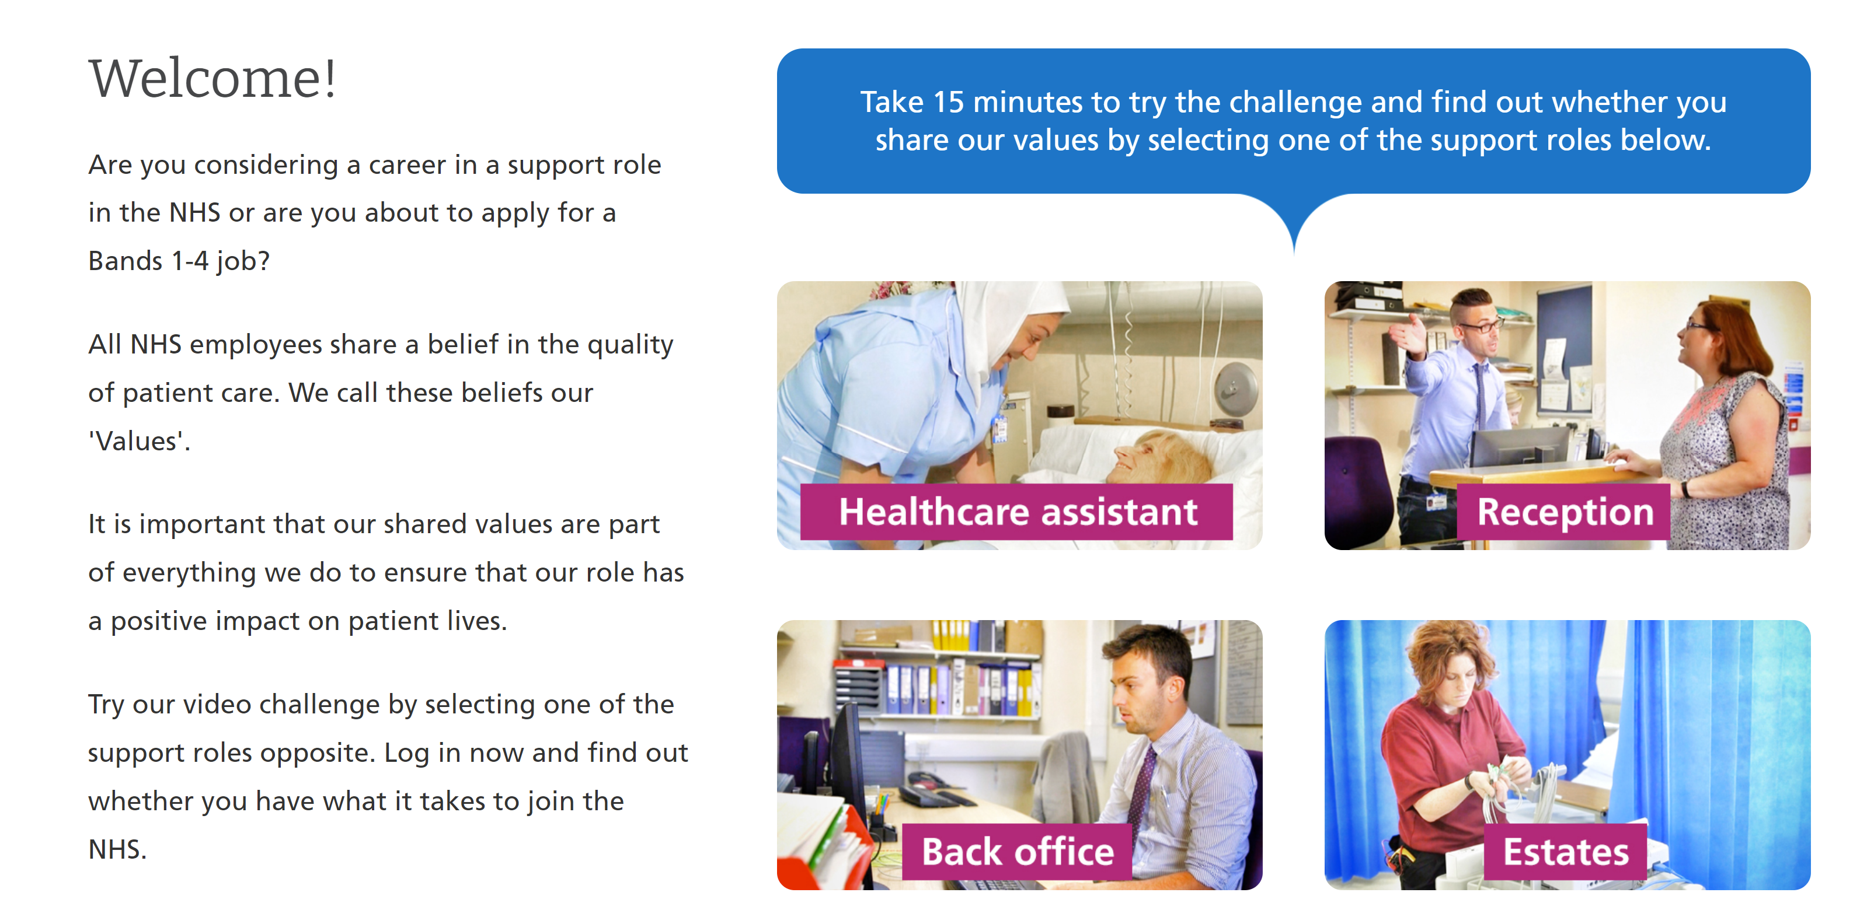
Values Challenge - click here to begin!
Values of the NHS Constitution
If you're applying for a job either directly in the NHS or in an organisation that provides NHS services, you'll be asked to demonstrate the values of the NHS Constitution and how they would apply in your everyday work.
You can find out more about NHS values here.
Complete the values challenge to see if you share the NHS’ values!

Slide 4
This programme is more than one day…
By joining this webinar, you are now a part of the Creating Careers family.
This includes The Liverpool City Region Careers Hub, Health Education England, GM Higher, Shaping Futures, NHS Careers NW, Lancashire Future U, Cumbria Hello Future and Cheshire and Warrington’s commitment to sharing opportunities that enable you to train towards a career in health and social care.
You can also independently sign up to Cheshire and Warrington Higher Horizons, Youth Hub by Be More and Cheshire and Warrington Opportunities who can help you to access these webinars and support you going forward.
Do you have any questions?
You can ask us about GCSE options, Sixth-Form or College choices and everything university related. Talk to the Shaping Futures team via live chat here or click on any of the above links for your area.
Creating Careers: Ask Us Anything - Health and Social Care Webinars
Build your health and social care knowledge! Even if you have an interest in one career role, these webinars are an opportunity to see how the 350+ NHS roles interlink to create a world-class health and social care system.
For more information, please see the next slide.

Slide 5
Creating Careers: Ask Us Anything
Health and Social Care Webinars
Season Two
Sign up here
Thursday 19th May:
Dental
Thursday 9th June:
Pharmacy
Thursday 23rd June:
Estates and Facilities
Thursday 7th July:
Healthcare Science
Develop your health and social care knowledge and receive free individual careers support across North West England
Each session is live from 4.30 pm - 5.30 pm
Year 9-13 students, North West England
Parents, carers and guardians are welcome
Find out more about the 350+ exciting careers in the NHS here.
Additionally, watch our Creating Careers video series to learn about the interesting health and social care career pathways that Liverpool City Region has to offer.
Don’t forget to check out the pre-work and Creating Careers Roadmap that accompany each episode!
Follow @LCRCareersEnt for the latest careers updates and events.

