Slide 1


Philippa Dickinson
Director of Student Services

Slide 2

What are T Levels?
2-year qualification
Post GCSE
They bring classroom learning and an extended industry placement together on a course designed with businesses and employers.
16-19 ( or up to 25 with an EHCP)
Notes:
New Level 3 quals being rolled out across the country in different phases
Post L2/GCSEs
Content/syllabus/standards have been heavily influenced by employers including the likes of IBM, BBC, NHS, in order to meet the current and future needs of businesses and the economy. They are focussed on education which leads to high quality employment opportunities. Combining classroom learning (knowledge, skills and workplace behaviours) with a long term industry placement with up to two employers over the course of the 2 years

Slide 3

T Levels are ideal for students who have finished GCSEs and want the knowledge and experience to get straight into employment, an apprenticeship or higher education.
80% in the classroom and 20% on a 45-day placement with an employer to gain knowledge and skills companies look for.
Notes:
For most T Level programmes, 80% of your time is spent in college, in classrooms, in specialist technical workshops, labs or simulated working environments, developing your technical skills, knowledge and expected behaviours, with 20% in the workplace, applying these and learning from your colleagues

Slide 4
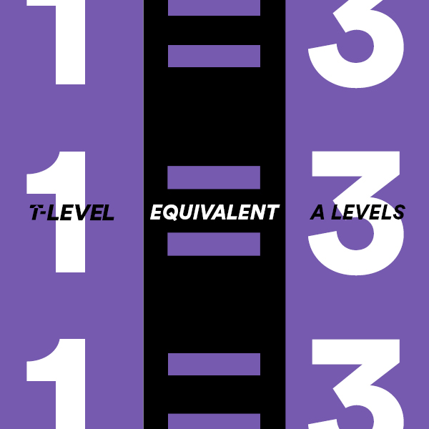
T Levels are level 3 qualifications which take 2 years of full time study and are equivalent to 3 A Levels.
Notes:
T Levels are the equivalent of 3 A levels – the government have introduced these programmes to provide a technical equivalent to A levels – L3 and for 2 years

Slide 5
The first 3 T Levels launched in September 2020, with a further 7 introduced in September 2021.
In September 2022, an additional 6 T Levels will be launched, with the remaining 7 beginning in September 2023.
At Wirral Met we will be offering 3 T Levels from September in: Onsite Construction - Carpentry and Joinery Digital Support Services Education & Childcare - Early Years Educator
Providers selected to deliver T Levels and providers planning to deliver the T Level Transition Programme - GOV.UK (www.gov.uk)

Slide 6


How will
T Levels be taught?

Slide 7
1
CORE COMPONENT
Between 20% and 50% of the qualification time
Technical knowledge and skills relevant to the chosen industry
An employer-set project
Notes:
Every T Level has a core component with focusses on the essential technical knowledge and skills for the industry. AN employer set project assesses the core component

Slide 8
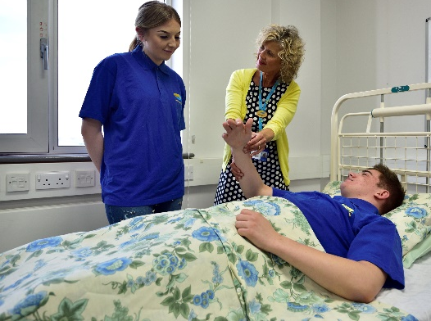

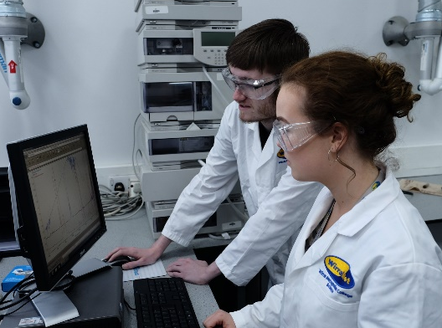
2
SPECIALIST SKILLS
Up to 80% spent in specialist learning environments developing skills and knowledge for specific jobs.
Notes:
Occupational specialisms - Assessed through synoptic practical assignments - explores understanding of the links between the core and specialist elements

Slide 9
3
INDUSTRY PLACEMENTS
develop the workplace skills that employers are looking for, gain a clearer idea about the job and learn about the opportunities to secure future employment.
20% spent on an industry placement – between 45-60 days *with the exception of Early Years Educator specialism at 21 weeks .
The structure will be chosen by the employer and the College and could include 10-20 weeks of 2-4 days a week.
Notes:
Takes place with an external employer – substantial and closely linked to the T Level specialism. Students apply knowledge and skills learned in college in the workplace and develop further knowledge skills and behaviours (on-the-job training)

Slide 10

Qualifications that count
Students achieve at pass, merit, distinction or distinction*.
Certificates detail components covered to help support the move into skilled employment or a higher apprenticeship.
Notes:
If you achieve a T Level you will be graded either pass, merit, distinction or distinction*

Slide 11
Awarded UCAS Points
T Levels are worth UCAS points – a T Level Distinction* is worth the same as 3 A Levels at A* – and will be recognised by universities and other education providers so you can choose to continue studying if you wish.
Notes:
A T level distinction* is equivalent to 3 A levels at A* and is recognised by universities in the same way

Slide 12
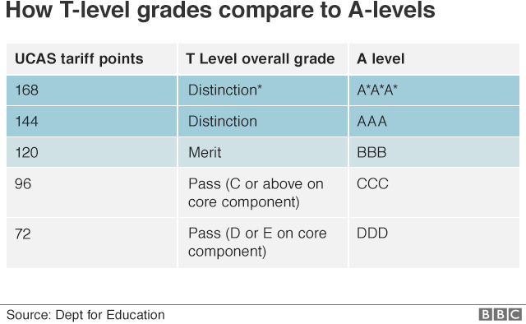

Slide 13
Progression Opportunities
Employment in a skilled occupation
A level 4, 5 or Degree Apprenticeship
Higher level study, such as a Higher National Certificate/Diploma, technical or professional qualification or a Degree at university

Slide 14
What are the differences between apprenticeships and T Levels?
Apprenticeship | T Level
80% in the workplace. | 20% on an extended industry placement: gives an overview of different roles and career routes within an industry.
20% off the job training i.e. an employment opportunity with training for those who are keen on working in a specific role. | 80% classroom-based developing knowledge and skills for jobs.

Slide 15
Level 2 Transition Programmes
Notes:
Entry criteria for T Levels at WMC are 5 GCSEs grade 9-4 including English Language and Maths

Slide 16
One year
These courses are specifically designed to develop the skills, experience, knowledge and behaviours to support progression onto a T-Level.

Slide 17

Any questions?

