Slide 1
Creating Careers: Ask Us Anything
Season Two
Orthoptics and Prosthetics
Thursday 27th January 2022
4.30 pm – 5.30 pm
Student Pre-work

Slide 2
Pre-work
1a) Click here to learn more about orthoptists, watch the videos and view local courses.
1b) To show your understanding of the role, list the top 3 skills* that you think an orthoptist would need to use each day. Make sure that you add an explanation next to all three choices.
*Skills = A skill is the ability to do something well.
For example, communication skills allow you to clearly communicate with someone so that they understand you. You can find more examples of skills here.
2a) Click here to learn more about prosthetics and orthotics, watch the videos and view local courses.
Using your own words, explain the difference between prosthetics and orthotics.
Our next Creating Careers webinar will focus on orthoptics and prosthetics but NOT orthotics.
Make sure that you have carefully completed the above tasks, so that you clearly understand the differences between the roles. They are easy to confuse!
Questions to ask
Using what you have learned from your pre-work, think of three questions that you would like to ask at our event.
Is there anything you don’t understand or would like more information on? You may even come up with more questions as you watch the webinar.
1.
2.
3.
Useful careers tips
Whilst listening, note down any inspirational or interesting advice that you hear which could help you on your careers journey
Now head over to your Creating Careers Roadmap to evaluate today’s event…

Slide 3
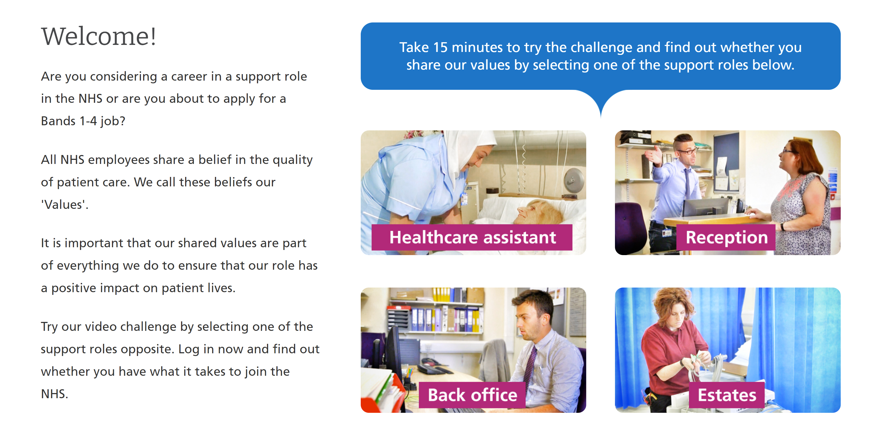
Values Challenge - click here to begin!
Values of the NHS Constitution
If you're applying for a job either directly in the NHS or in an organisation that provides NHS services, you'll be asked to demonstrate the values of the NHS Constitution and how they would apply in your everyday work.
You can find out more about NHS values here.
Complete the values challenge to see if you share the NHS’ values!

Slide 4
This programme is more than one day…
By joining this webinar, you are now a part of the Creating Careers family.
This includes The Liverpool City Region Careers Hub, Health Education England, GM Higher, Shaping Futures, NHS Careers NW, Lancashire Future U, Cumbria Hello Future and Cheshire and Warrington’s commitment to sharing opportunities that enable you to train towards a career in health and social care.
You can also independently sign up to Cheshire and Warrington Higher Horizons, Youth Hub by Be More and Cheshire and Warrington Opportunities who can help you to access these webinars and support you going forward.
Do you have any questions?
You can ask us about GCSE options, Sixth-Form or College choices and everything university related. Talk to the Shaping Futures team via live chat here or click on any of the above links for your area.
Creating Careers: Ask Us Anything - Health and Social Care Webinars
Build your health and social care knowledge! Even if you have an interest in one career role, these webinars are an opportunity to see how the 350+ NHS roles interlink to create a world-class health and social care system.
For more information, please see the next slide.

Slide 5
Creating Careers: Ask Us Anything
Health and Social Care Webinars
Season Two
Sign up here
Thursday 13th January:
Dietetics, Speech & Language
Therapy and Dramatherapy
Thursday 27th January:
Orthoptics and Prosthetics
Thursday 10th February:
Diagnostic and
Therapeutic Radiography
Thursday 10th March:
Podiatry, Art and
Music Therapy
Thursday 24th March:
Operating Department
Practitioners and Paramedics
Develop your health and social care knowledge and receive free individual careers support across North West England
Each session is live from 4.30 pm - 5.30 pm
Year 9-13 students, North West England
Parents, carers and guardians are welcome
Find out more about the 350+ exciting careers in the NHS here.
Additionally, watch our Creating Careers video series to learn about the interesting health and social care career pathways that Liverpool City Region has to offer.
Don’t forget to check out the pre-work and Creating Careers Roadmap that accompany each episode!
Follow @LCRCareersEnt for the latest careers updates and events.

Slide 6
Coming Soon On
Creating Careers: Ask Us Anything
2022
Ambulance Services
Dentistry
Pharmacy
Estates & Facilities
Healthcare Science
Find out more about each of these careers here.
Got a question?
Get in touch:
careershub@
growthplatform.org

